Slide 1
Chapter 6: Fine-tunnig

Slide 2
What is Fine-Tuning?
Fine-tuning = taking a pre-trained model and training it a little more on our own data.
Instead of training from zero (which is expensive), we:
Take a model already trained on huge data
Adjust it slightly for our specific task
Examples:
Sentiment classification
Medical chatbot
Legal document summarizer
Code generation

Slide 3
Types of Fine-Tuning
Full Fine-Tuning
Feature Extraction*
Parameter Efficient Fine-Tuning (PEFT) {ex. LoRA, Adapters} → used in modern LLM’s

Slide 4
6.1 Different categories of finetuning

Slide 5
Instruction Fine-Tuning
Example 1 – Task Following
Instruction: Summarize the following paragraph in one sentence. “Artificial Intelligence is transforming industries by automating repetitive tasks, improving decision-making through data analysis, and enabling new applications such as autonomous vehicles.”
Model Output: Artificial Intelligence improves industries by automating tasks and enhancing data-driven decision-making.

Slide 6
Classification Fine-Tuning
Example 1 – Sentiment Classification
Input: “The product quality is excellent and delivery was fast.”
Model Output: Positive

Slide 7
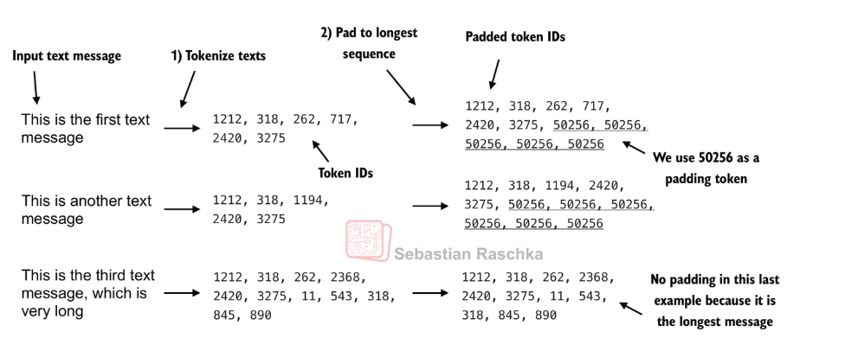
6.3 Creating data loaders

Slide 8
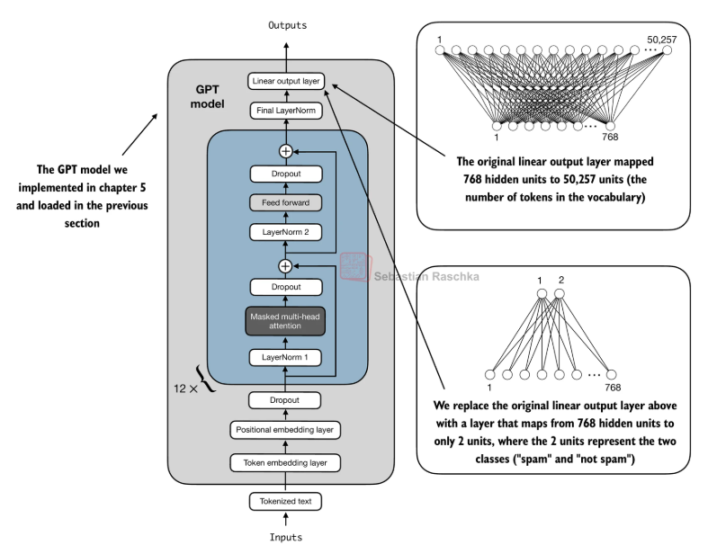
6.5 Adding a classification head

Slide 9
